Slide 1
knowledgebot

Slide 2
acknowledgement
“The work has been completed under the guidance of
Dr. Yugi Lee, Raj Marri,
and
TA’s (SaiSri Narne, Gaikwad Priyanka)
CS5551 Advanced Software Engineering, University Of Missouri – Kansas City, Spring 2020” .

Slide 3
TEAM DETAILS team 06
Harini Reddy Anumandla- 03
Pooja Reddy Gopu -14
Vennela Kovuru-18
Jagruthi Bobbala-33

Slide 4
SOFTWARE REQUIREMENTS
Angular
Bootstrap 4
Heroku
Node js
Mongo DB
DialogFlow
Reactive forms

Slide 5
INTRODUCTION
Knowledge Bot is a chatbot. Chatbot is a software where user communicates with Bot.
Knowledge Bot is basically a texting application. When the user asks the question, it gives the response based on his/her interest.
For example, if the user asks question “which is the best tutorial for Python?”
Knowledge Bot will reply the user with the best tutorial for Python.
The data requested by the user will be shown in the form of a video/link. This application is feasible to all and accessible everywhere.

Slide 6
Objective
KnowledgeBot is basically designed for making it easy to find all the required data at a place.
When the user asks for a data, they can access either videos or google links at the same place.
They also have references for several language tutorials, their installations, few IDE installations and playground to try to there itself.
The response is given based on the user preferences and expertise.

Slide 7
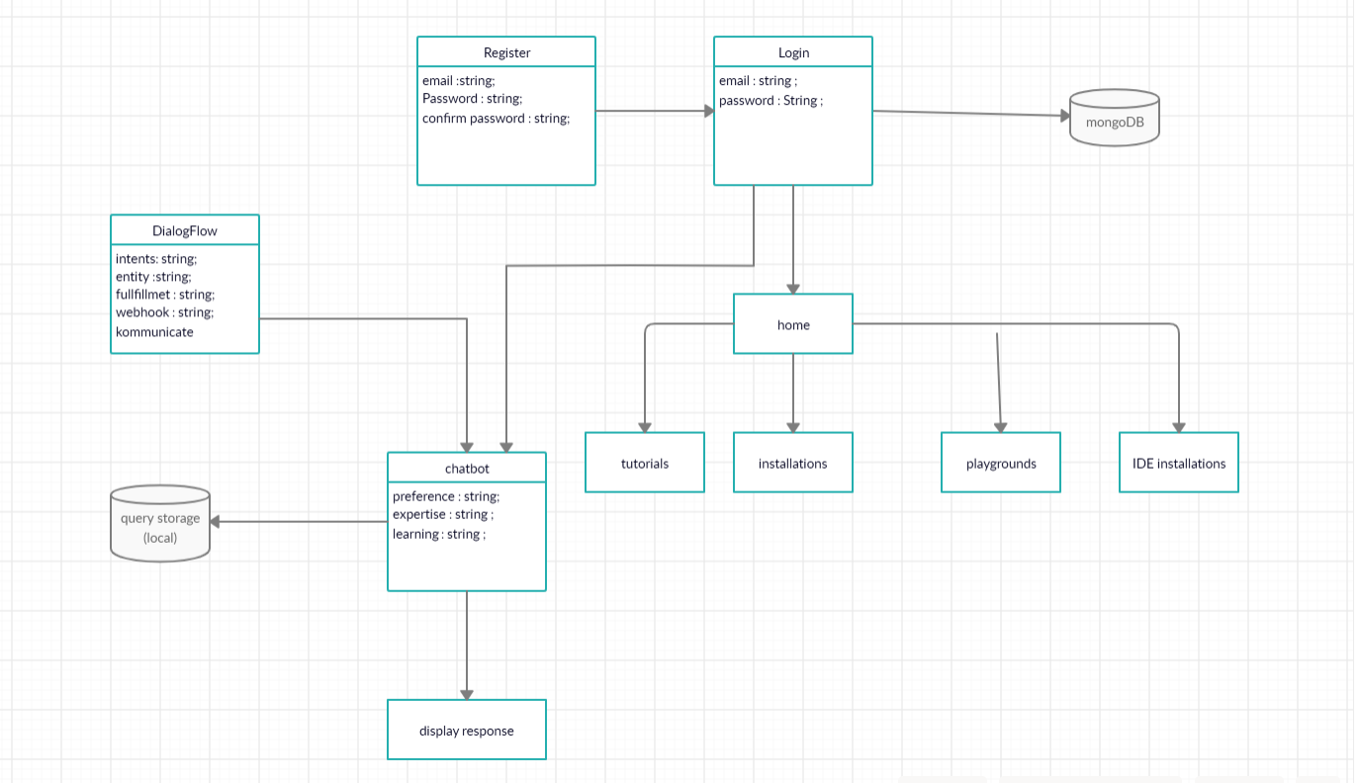
UML diagram

Slide 8
FEATURES
Secure authentication
Validation messages
Alert messages
Tutorials and their installations
Playgrounds and a few IDE installations.
Chat section for user.
User preferences and expertise

Slide 9
FEATURES
Responsive UI for web
User friendly UI
Pre trained bot
Integrates with dialogflow
Free to explore
Easily Accessible

Slide 10
Implementation
Created sign in and sign up pages.
Created validation messages and authentication using reactive forms.
Created a home component to display the tutorials, their installations, playgrounds and a few IDE installations.
Integrated chat component using kommunicate.io
Developed chat flow using dialog flow.
Used webhook to integrate third party API’s.
Developed response according to the user preferences, the expertise level and display data according to the user requirement.
Deployed it in aws.

Slide 11
HOW IT WORKS?
First the user asks regarding a technology or course he wants to learn.
Then the bot asks for the preference of the user, whether he wants a course/project/codechallenge.
After user selects the preference, bot asks the user about his expertise whether user is a beginner/intermediate/expert.
After choosing the expertise, the bot asks user to select the method to utilize the response i.e., video/text .
Then the bot replies with the accurate response according to the user requirements.
User can also access the tutorial/installations and use the playground.

Slide 12
Components
Dialogflow : used this to train the bot. It uses natural language processing to match the intents. We used agent, intents and fulfillment to train our bot.
Webhook : used to integrate third party API. we need a global URL hence we deployed the webhook code to Heroku with as videowebhook.
Kommunicate: The Chat widget we used in the application is the custom widget provided by the website Kommunicate.io. We integrated dialogflow with kommunicate and added the widget in the application.
MongoDB: MongoDB is a cross-platform and open-source document-oriented database, a kind of NoSQL database. We are storing user ids , passwords in mongodb. For the login authentication also we get the data from the storage.

Slide 13
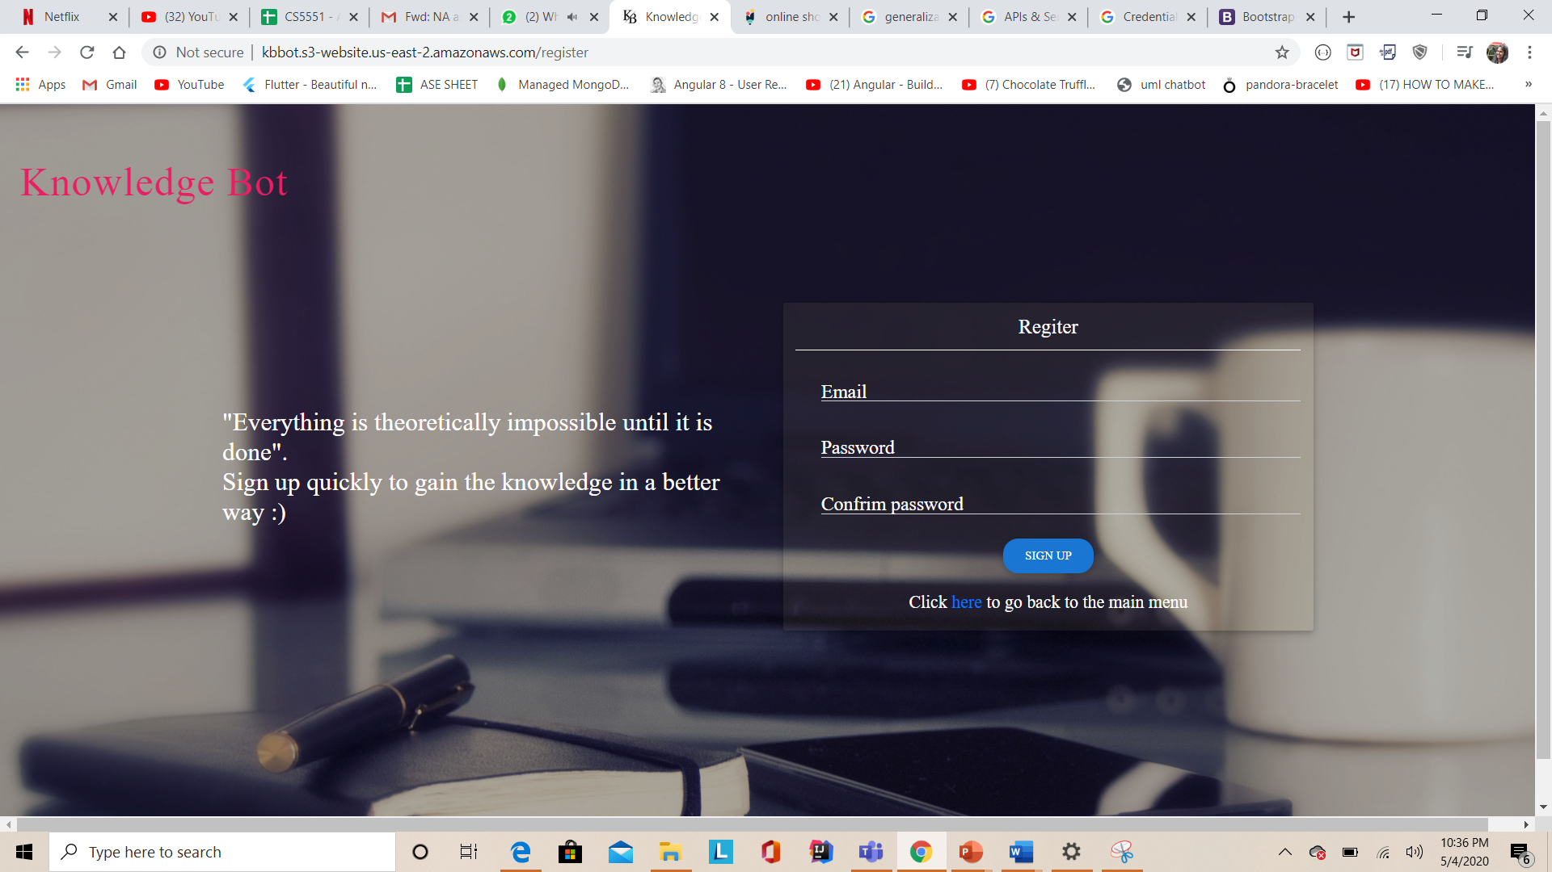
DESIGN

Slide 14
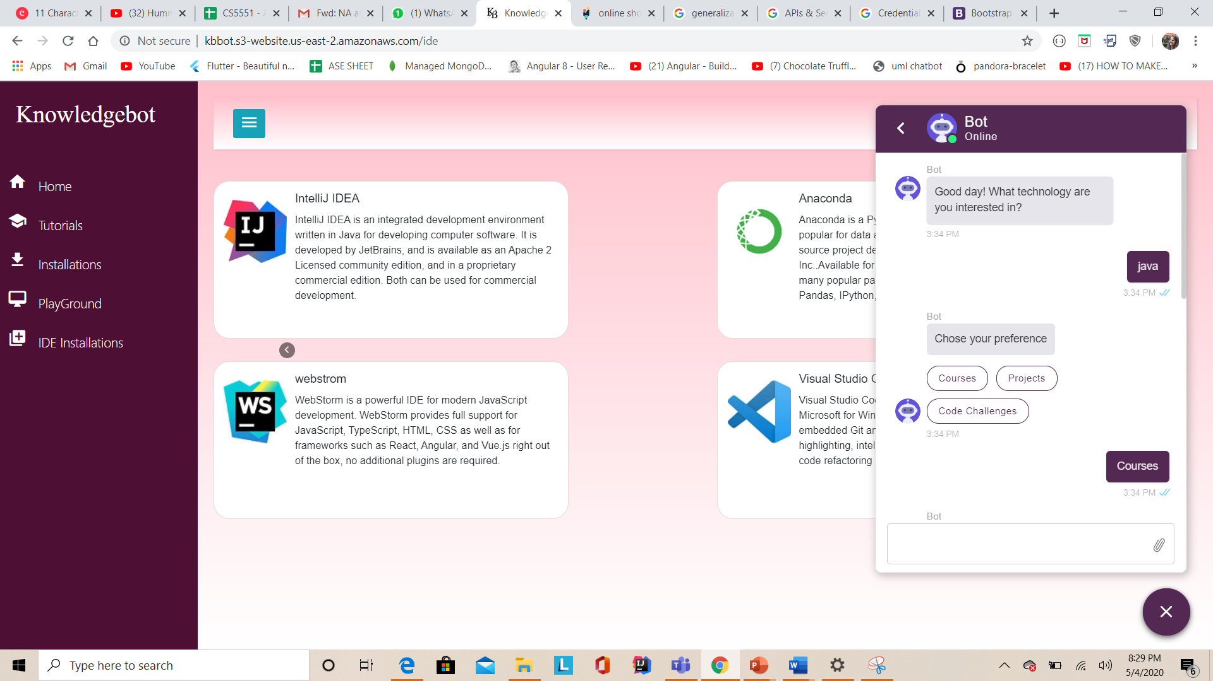
DESIGN

Slide 15
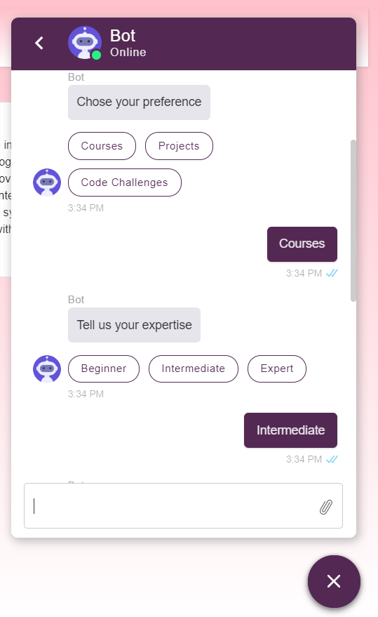
CHAT DESIGN

Slide 16
References
https://dialogflow.com/
https://www.kommunicate.io/
https://dashboard.heroku.com/apps/videowebhook
https://getbootstrap.com/
https://cloud.mongodb.com/v2/5e585ed7b949ef1c7fb99c0e#security/database/

Slide 17

Any questions?

Slide 18
Thank you

